Slide 1
Smart conditioning system
Done by: kareem farwagi
sanad muhyar
and Njoud saleh

Slide 2
introduction
smart conditioning system and its goals
In this project, we are presenting a smart conditioning system, which is capable to provide the ideal cooling or heating conditions depending on the actual temperature. The system works on turning on or off a fan or a heater after reading the ambient temperature using the famous temperature sensor. In addition, the system provides a smart feature that ensures that the safety of the user is in safe hands; this is applied by using an infrared sensor that turns on a buzzer and an LED if any object moves close to the system. In this way, the LED and the buzzer will work together as an alarm system.

Slide 3
The Components of a smart conditioning system
Temperature sensor
Fan/heater
IR sensor
Buzzer
LEDs
Nmos
LCD
Mechanical Relay

Slide 4
How it works
Explaining how the temperature sensor works and how it reads the ambient temperature
The LM35 is a precision integrated-circuit temperature sensor that can be used to read the ambient temperature. It is a linear sensor, which means that its output voltage is directly proportional to the temperature. To use the LM35 sensor, it must be connected to an electronic device, such as a microcontroller or data logger. The sensor has three pins, Vcc, GND, and Output. The microcontroller measures the output voltage of the sensor and converts it into a temperature reading using the equation: Temperature (in °C) = (Output Voltage (in mV) / 10.5). This sensor is highly accurate, has a low offset voltage, and it requires no external calibration or trimming to provide typical accuracies of ±1/4°C at room temperature and ±3/4°C for a full -55 to 150°C temperature range.

Slide 5
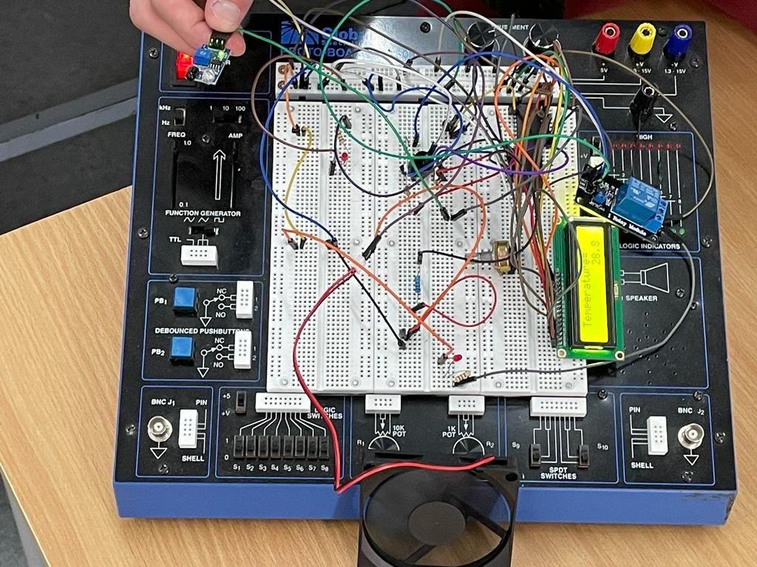
Figure 1: Top view of the mechanical design

Slide 6
Fan/heater control
How the sensor reading is used to control the fan/heater
The LM35 sensor reading can be used to control the fan and heater by connecting it to a microcontroller. The microcontroller will read the output voltage of the LM35 sensor, convert it into a temperature reading and compare it to a setpoint temperature. In case the temperature reading is higher than the setpoint temperature, the microcontroller sends a signal to turn on the fan to cool down the environment, and continuously monitors the temperature reading and adjusts the speed of the fan accordingly to maintain the setpoint temperature. In case the temperature reading is lower than the setpoint temperature, the microcontroller sends a signal to turn on the heater to warm up the environment, and continuously monitors the temperature reading and adjusts the heating power accordingly to maintain the setpoint temperature.

Slide 7
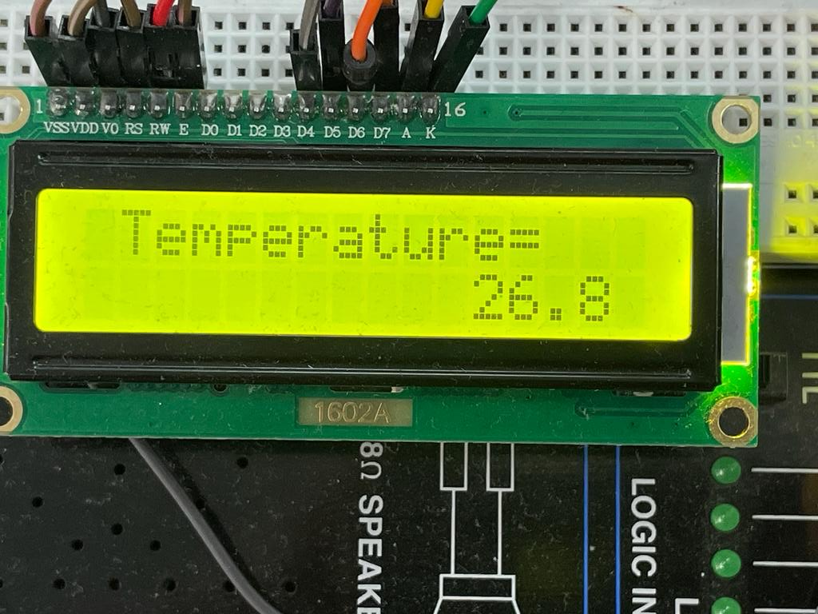
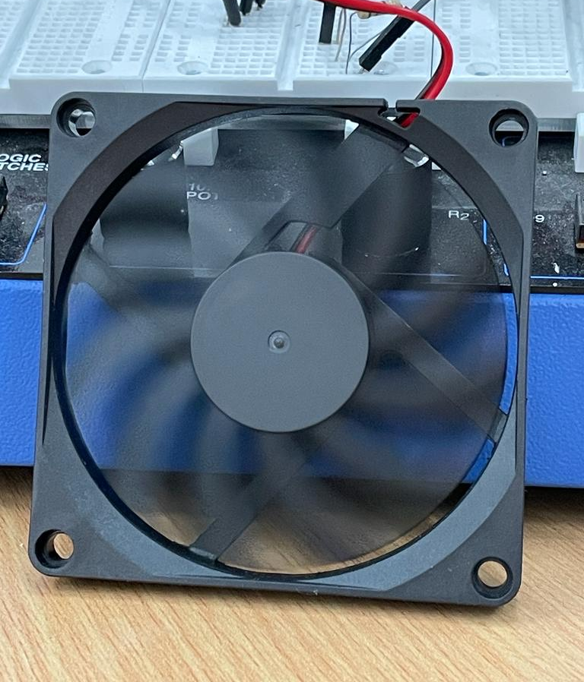
Figure 2: Fan working on 50% duty cycle when temperature is less than 28 and more than 25

Slide 8
Safety feature
Explain how the infrared sensor works
An infrared sensor is a device that detects infrared radiation, which is a type of electromagnetic radiation emitted by all objects above absolute zero (-273.15°C) and it can be used to detect the temperature of an object without having to make physical contact with it. The most common infrared sensor is the thermopile sensor, which is composed of several thermocouples connected in series, which generate a small voltage when they are exposed to infrared radiation. The infrared sensor works by focusing infrared radiation onto a thermopile using a lens or mirror, the thermopile generates a small voltage which is then amplified and converted into a temperature reading. The sensor then sends this information to a microcontroller or data logger for further processing. It's important to note that Infrared sensor have a certain range of wavelength they are sensitive to, and it's affected by the emissivity of the surface being measured.
Showing how the sensor is used to detect movement and trigger the alarm
Describing how the LED and buzzer work together as an alarm system

Slide 9
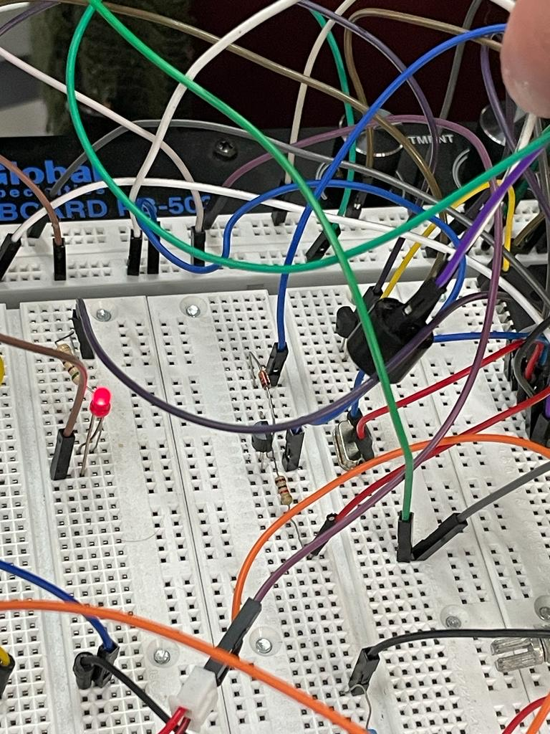
Figure 3: LED is ON and Buzzer makes noise while infrared detects motion

Slide 10
Conclusion
This temperature-controlled fan and heater system provides precise control over temperature and airflow, while also ensuring user safety through the implementation of an infrared sensor. The system is easy to use, and the LCD display provides clear and accurate information about the temperature and safety status of the system. The use of C programming language and PIC16F877A microcontroller makes it reliable and efficient.

